Slide 1
CUSTOM MUST-KNOWS
B’s Culture Studio — Workshop #5
Nov. 7, 2011
--Cultural Do’s & Don’ts--
Anita Wu
Helen Kuo
Joey Hsu
Nancy Lee

Slide 2
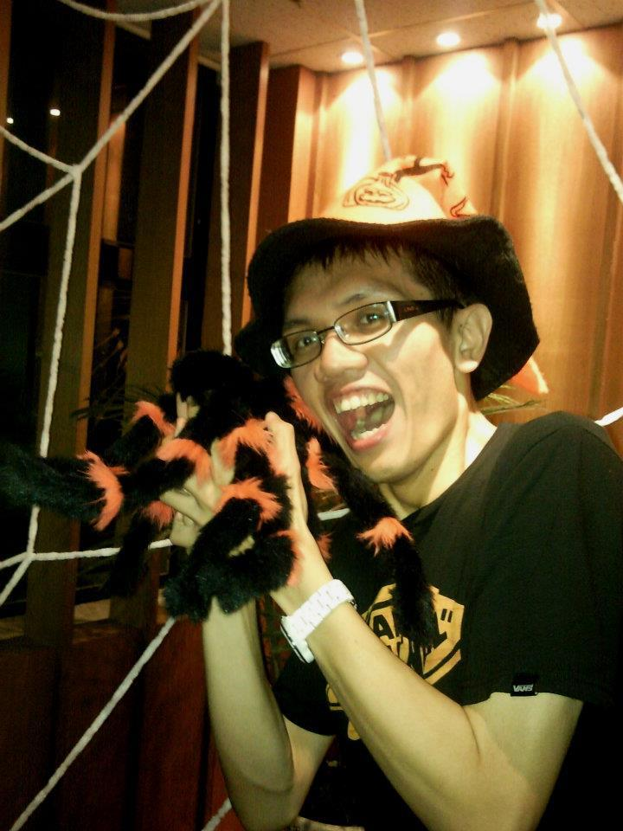
PERSONAL PROFILE
Name- Joey Hsu(52)
PhD of Culture Studies
CEO of J’s Culture Studio
Specialty- Cultural Events & Promoting Taiwanese cultural significance

Slide 3
TODAY’S SHARING…
Some important moments in my life.
Some must-known cultural traditions and taboos
Comparison
Values and cultural meanings behind the traditions

Slide 4
THE TIMES OF MY LIFE
Birth
Naming
Zuo Yuezi
Man Yue
Start Business
Feng-Shui
Yin-Yang
Marriage
Wedding
customs
  Temple Worship
  Fortune Telling
  Red Envelope

Slide 5
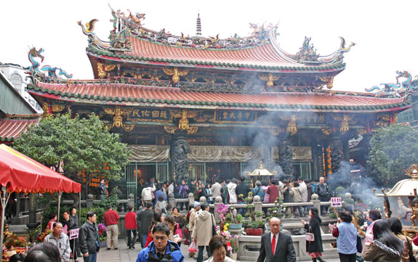
TEMPLE WORSHIP
Image Source: http://taipei.traveleredge.com/GRAPH/longshan_1088.jpg

Slide 6
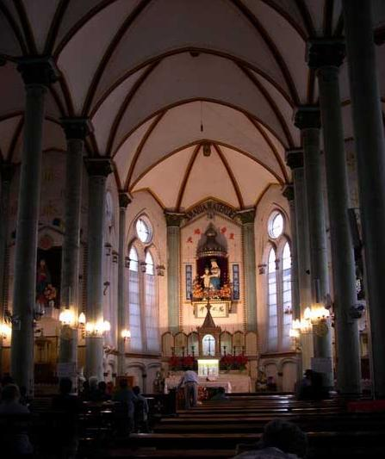
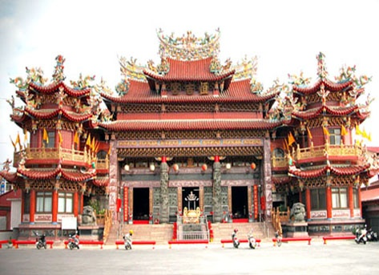
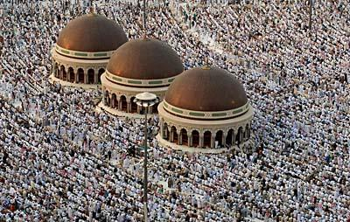
MULTI-RELIGIONS
Image Source: http://www.newsancai.com/index.php/big5/news/8354.html?task=view
http://big5.showchina.org:81/gate/big5/www.showchina.org/tour/jdtj/200908/t385083.htm
http://travel.nantou.gov.tw/01legend_main.asp?Id=401

Slide 7
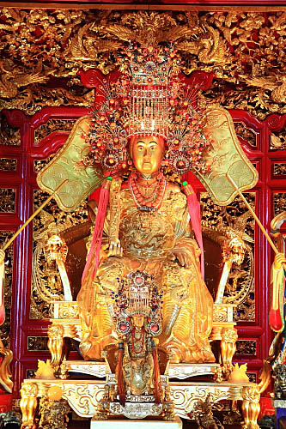
Mazu (媽祖)
Guardian of sailors
Image source: http://www.sxgyh.com/dstdshow.asp?d_id=168/
Notes:
7

Slide 8
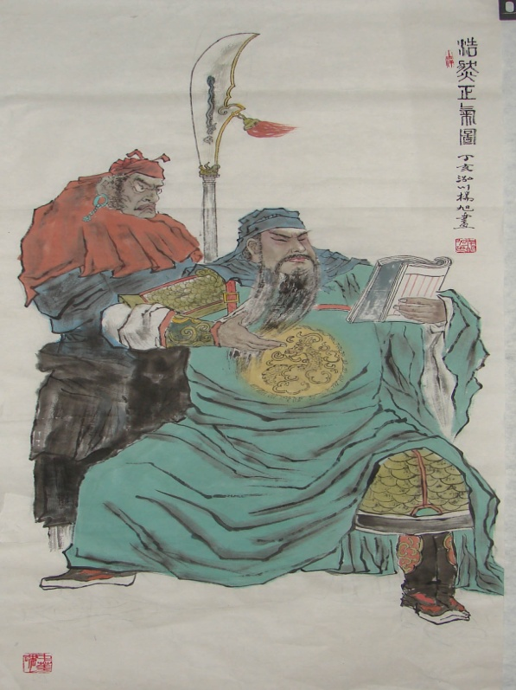
Guan Gong
(關公)
The god of war
Patron god of
merchants
Image souce: http://tw.myblog.yahoo.com/rex-3600/article?mid=2323&prev=2327&l=d&fid=14

Slide 9
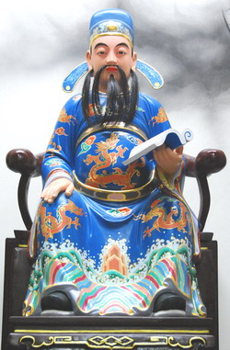
Wen Chang Di Jun (文昌帝君)
The god of wisdom
Image Source: http://www.yuhlonggong.idv.tw/D/D1/D12/new_page_%E6%96%87%E6%98%8C%E5%B8%9D%E5%90%9B.htm

Slide 10
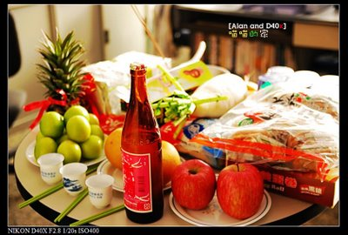
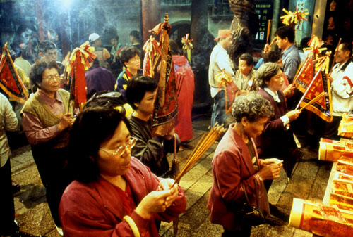
When to worship?
  Anytime uncertain about anything
  Anytime wishing/praying for safety/good luck
  Anytime encountering difficulties
  Anytime seeking purification/catharsis
  Anytime eager to confess
mage Source: http://m31507.edublogs.org/files/2010/01/拜拜1.jpg http://alan0919.blogspot.com/2009/01/126_26.html

Slide 11
Dos | Don’ts
BEFORE Wash hands DURING Hold a pietistic attitude Hold the incense sticks upright AFTER Fold the ghost paper into half piece by piece to show respect and sincerity when burning it | OFFERINGS Should not be repeatedly used or eaten before Avoid offerings like dog meat, eels or beef, etc. OTHERS Do not enter a temple through the door in the middle Female should not go worship when having the periods or are pregnant (Superstitions!)

Slide 12
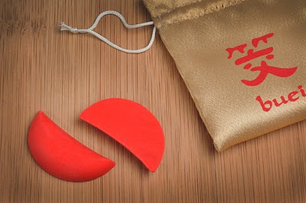
THE GODS ANSWERS: DIVINATION BLOCKS
Usage: Communication with the gods
1. Find two blocks in the block tray.
2. Hold both blocks in your closed hands.
3. State your name, date of birth, address and phrase your question in YES/NO fashion.
4. Toss the blocks onto the ground.
5. Read the answer given by the blocks.
6. Thank the temple god for sharing his/her wisdom.
7. Place the blocks back in the block tray.
Text Source: Taiwan A to Z The Essential Cultural Guide
Image Source: http://no18wtp.blogspot.com/2010/05/inkbuei.html

Slide 13
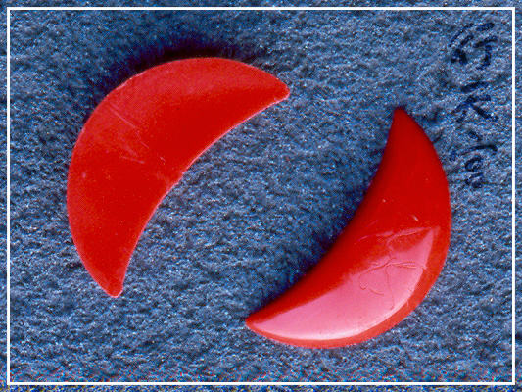
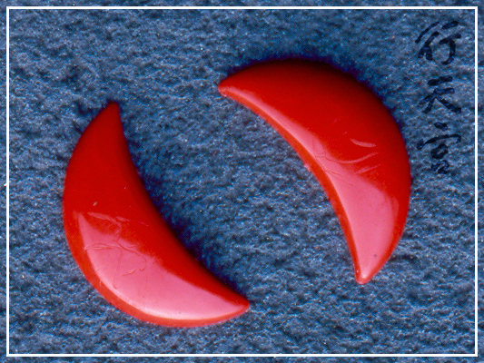
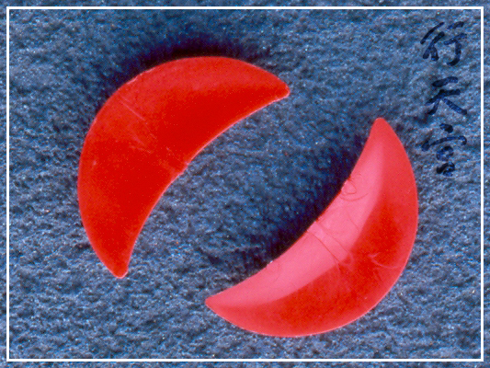

HOW TO READ THEM?
Image source: http://www.ht.org.tw/religion/re7_1_2.htm
YES!
NO!
Laughing Blocks

Slide 14
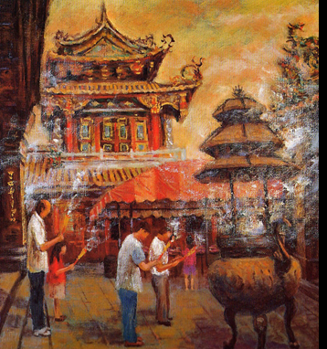
WHAT IT MEANS TO TAIWANESE--
  Group-orientation
  Piety
  Satisfaction: yuanman (圓滿)
  Frankness and simplicity of farmers’ characteristics and life in the early Taiwan
  Image Source: http://sales.artlib.net.tw/work_detail.php?imgID=16346

Slide 15
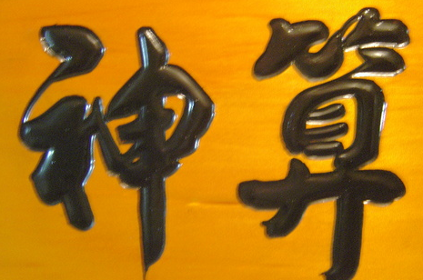
FORTUNE TELLING
Image Source: http://profile.ak.fbcdn.net/hprofile-ak-ash2/187949_202495266429193_2539735_n.jpg

Slide 16
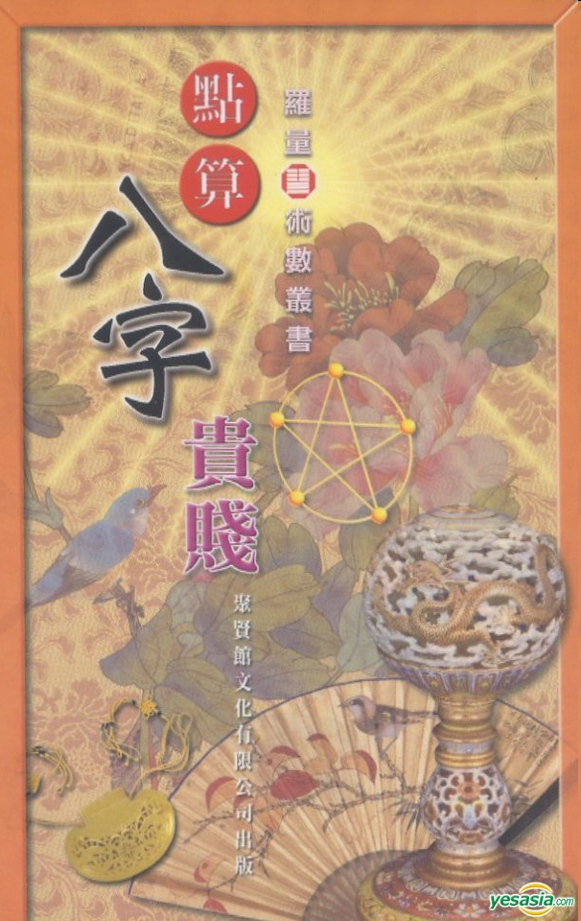
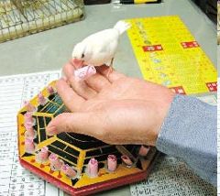
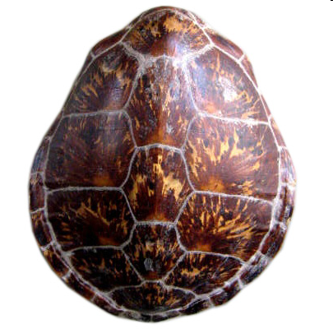
Bazi (八字):
Fortune Telling Birds (鳥掛):
Tortoise Shell (龜掛):
Ｉｍａｇｅ ｓｏｕｒｃｅ：
http://www.yesasia.com/global/點算八字貴賤/1011415963-0-0-0-zh_TW/info.html
http://www.1stdibs.com/furniture_item_detail.php?id=269377
http://mag.udn.com/mag/happylife/storypage.jsp?f_ART_ID=71677

Slide 17
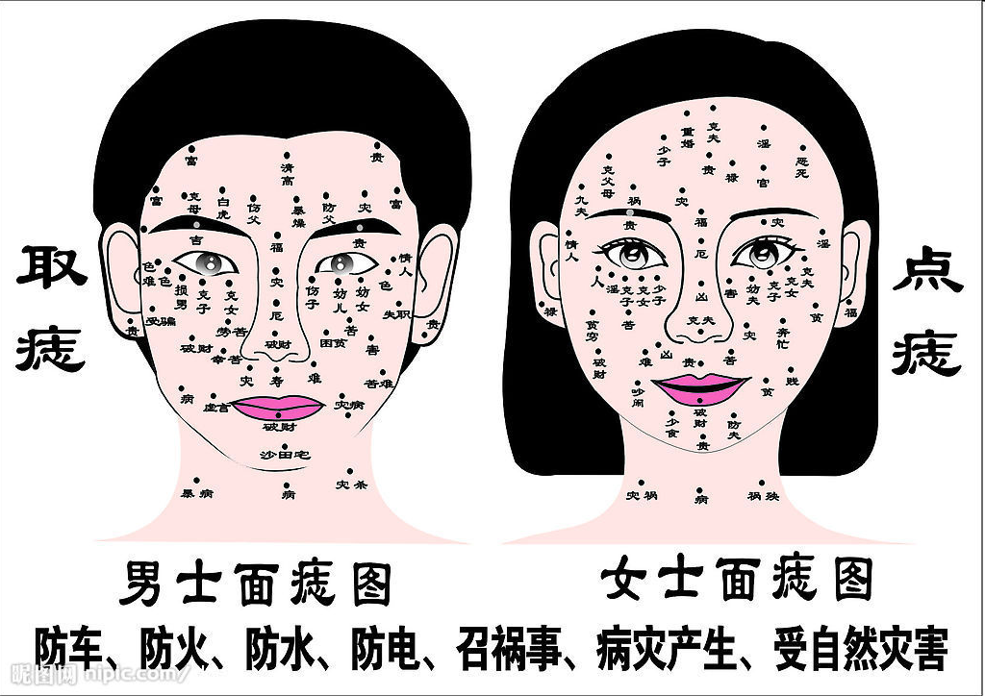
FACE READING (面相)
Image source: http://www.nipic.com/show/3/66/4de7821eefe392c0.html

Slide 18
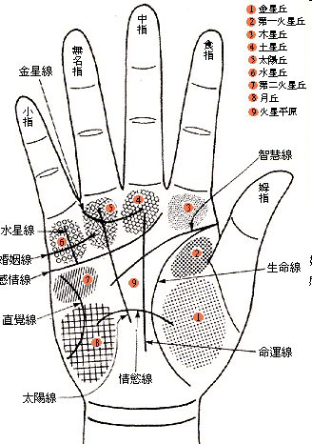
PALM READING (手相)
Image Source: http://members.hknet.com/~chius/palm/hand.htm

Slide 19
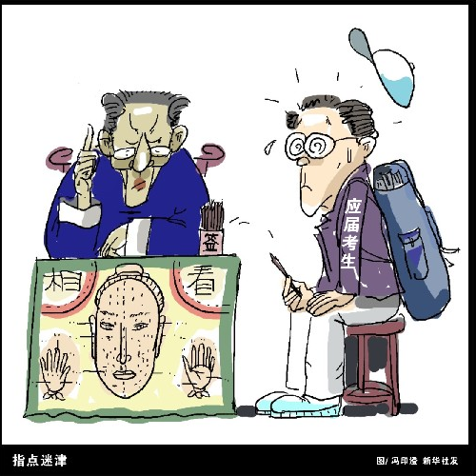
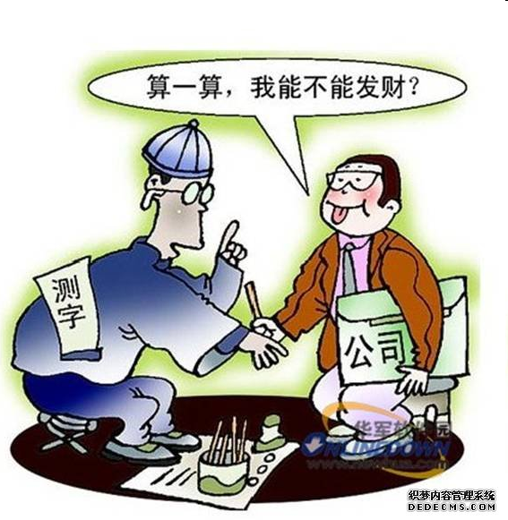
Taiwanese people go to a fortune teller to ask for….
Understanding of their fates
Advice
Answers
Guidance
Text Source: Taiwan A to Z The Essential Cultural Guide
Image source:http://www.ahaw-43.com/post/195.html
http://news.xinhuanet.com/edu/2006-05/23/content_4587179.htm

Slide 20
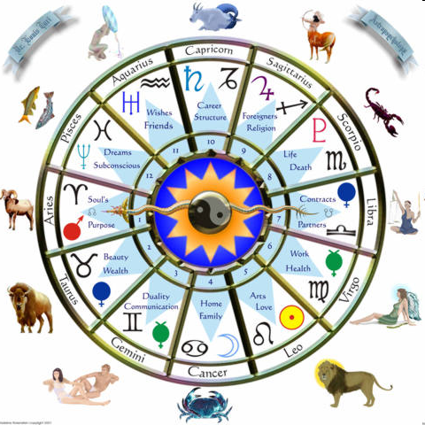
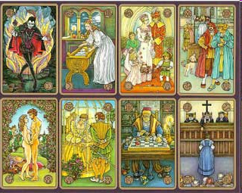
Fortune Telling
V.S
Astrology
Tarot card reading
Image Source: http://forastrologyzone.com/astrology-zone-2/
http://www.silvermoontarotcards.co.uk/

Slide 21
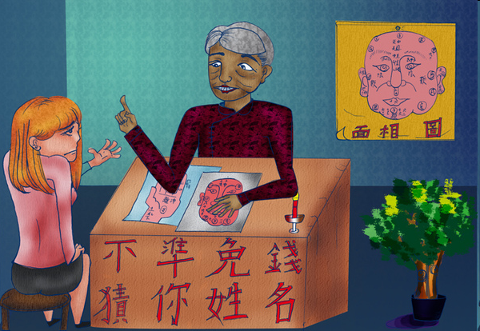
Cultural Significance
Seeking & following directions of the “authorities” (teachers, parents, the elderly, etc.)
Possibilities in changing one’s fortune
Text Source: Taiwan A to Z The Essential Cultural Guide
Image Source: http://ohsanny.pixnet.net/blog/post/26522253

Slide 22
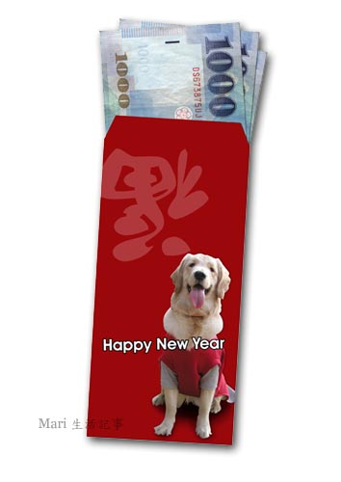
DIFFERENT WAYS OF GIFTS GIVING
Comparison
West: http://www.gifts.com/ideas/wedding
Taiwan:
Image Source: http://b0.rimg.tw/elle329/402c53aa.jpg

Slide 23
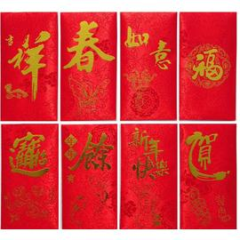
RED ENVELOPES
When to give red envelopes?
  Celebration of a new-born baby
  Promotion / New Operation of Business
  Celebration of someone buying a new house/apartment
  Wedding
  Birthday Party esp. the seniors’
  Chinese New Year
  Moment to show gratitude and apology
  Visiting invalids
  Text Source: Taiwan A to Z The Essential Cultural Guide
  Image Source: http://www.pcstore.com.tw/tzecheng/M07683762.htm
Notes:
replace“Visiting people hospitalized ”with “visiting invalids”

Slide 24
Please remember…
Dos | Don’ts
NUMBERS/AMOUNT Give even numbers of amount in hongbao e.g. 200, 600, 1000, 1600, 2000, 2200, 2600, 3000, 3200, 3600, 6000, 6600, etc. Give the proper amount based on the “guanxi.” COLOR Use RED envelopes only instead of other colors. | NUMBERS/AMOUNT Never give odd numbers of amount in hongbao e.g. 300, 500, 700, etc Never give amount in multiples of four e.g. 400, 1400, 2400, etc
Text Source: Taiwan A to Z The Essential Cultural Guide

Slide 25
Red Envelopes
Cultural Significance and Value Lying Behind
- Harmony
- Face
- Auspiciousness
Image Source: http://www.pcstore.com.tw/tzecheng/M07683762.htm

Slide 26
The time of Joey’s life
Birth
Naming
Zuo Yuezi
Man Yue

Slide 27
When naming the baby…
Dos | Don’ts
Consider… the baby’s Eight Characters the basic Five elements. the total number of strokes in the name Sound and rhythm | Try to avoid… name after an elder member in the family puns. words that are hard to be pronounced
Text Source: Taiwan A to Z The Essential Cultural Guide

Slide 28
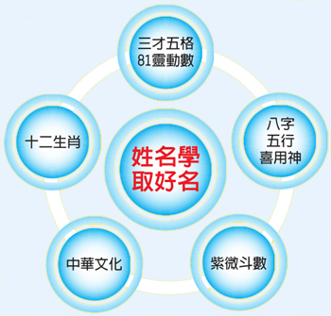
Why should we care?
Each word can be effective.
Balance between the five elements can lead to a better life.
Sharing the same word with an elder member of the family is considered offensive.
Text Source: Taiwan A to Z The Essential Cultural Guide
Image Source: http://www.life-guide.com.tw/images0929/350.jpg

Slide 29
Zuo Yuezi
Meaning
  Doing the month
  Help the mother to recover from delivery
Where to go?
  At home
  Private Zuo Yuezi Center
Text Source: Taiwan A to Z The Essential Cultural Guide

Slide 30
Within that very month…
Dos | Don’ts
Nothing except lying in bed Eat food that are considered “hot” Drink medicine beverage made of Chinese herbs Rest, rest, and rest… Warm towel bath. | Cold or icy drinks “Cold” food, raw food, Be exposed to the wind. Get tired Baths, showers, washing hair…
Text Source: Taiwan A to Z The Essential Cultural Guide

Slide 31

Image Source: http://www.idovideo.org/img/wegomoonrest.jpg

Slide 32
WHY???
In old times, women died easily after giving birth.
The balance between yin and yang, hot and cold.
Only with a healthy body can a woman produce MORE CHILDREN!
Text Source: Taiwan A to Z The Essential Cultural Guide

Slide 33
MAN YUE
Meaning
  The baby’s first month of life
  The first time the new born being introduced to the rest of the family
  Celebrating the joy of having a new life in the family with relatives and friends
Text Source: Taiwan A to Z The Essential Cultural Guide

Slide 34
How to celebrate?
A big party
Invite all the relatives and friends
Accepting gifts from guests
  Red envelopes, golden jewelry(necklaces, rings, bracelets…etc), clothes are popular gifts
Gifts for guests
  Red eggs
  Sticky rice (usually if it’s a baby boy)
  Sweets & cakes (usually if it’s a baby girl)

Slide 35
Meaning behind celebration
New born babies are fragile.
Boys’ parties are more celebrated, different gifts to the guests– boys are more valuable
Text Source: Taiwan A to Z The Essential Cultural Guide

Slide 36
THE TIME OF JOEY’S LIFE
Start his own business!
Feng-Shui
Yin-Yang

Slide 37
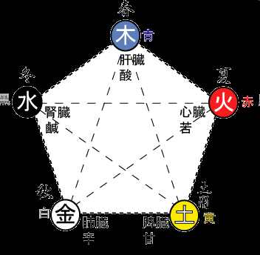
FENG SHUI (風水)
“Wind-water”
Ancient Chinese art of tapping onto the earth’s 5 elements (earth, fire, metal, water, wood) to boost energy, health and prosperity.
Image Source: http://www.houju.co.jp/gogyou.html
Text Source: Taiwan A to Z The Essential Cultural Guide

Slide 38
Feng shui is used for…
Locations
e.g., where to buy the house, a suitable burial site
Directions
e.g., the direction of the stove in the kitchen, position of the bed in the bedroom
Text Source: Taiwan A to Z The Essential Cultural Guide

Slide 39
SOME BASIC RULES…
Dos: | Don’ts:
The most favorable home direction →the front door to be facing south Using a crystal ball, lucky bamboo and a laughing Buddha | living in a house with a front door indirectly facing onto a street sleeping with feet directly towards the door Having a window or a door behind you
Text Source: Taiwan A to Z The Essential Cultural Guide

Slide 40
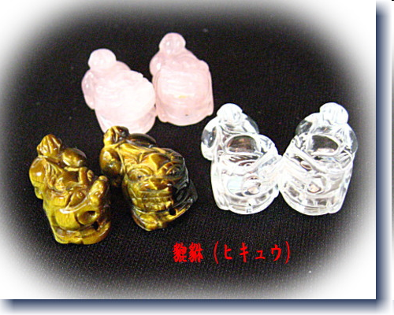
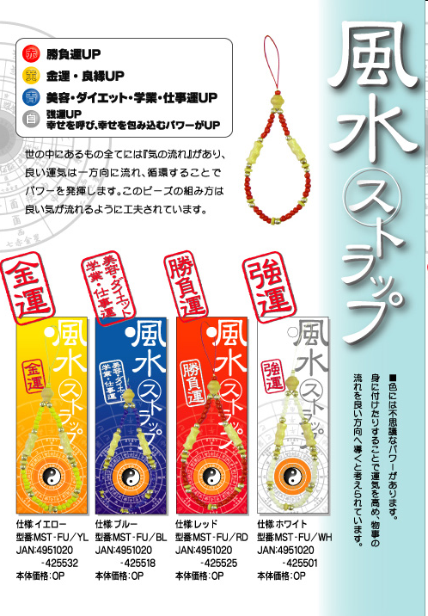
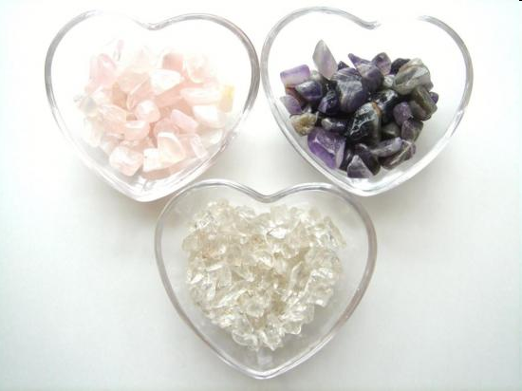
Image source:
http://kaiunet.ds-comp.com/2006/10/post_73.html
http://izumo.mypl.net/shop/00000300523/news?d=70290
http://www.memory-inc.co.jp/products/fusui/index.html

Slide 41
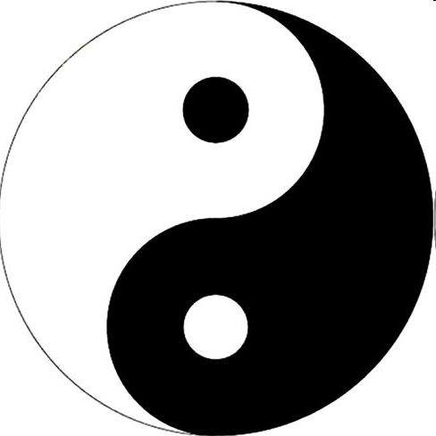
Yin Yang (陰陽)
Outer circle →completeness
Black & white shape→ yin & yang energies
Curved dividing line →continual interchange of yin & yang
White and black dots→ nothing is completely black or white
Text Source: Taiwan A to Z The Essential Cultural Guide
Image source: http://www.epochtimes.com/b5/5/8/16/n1020427.htm

Slide 42
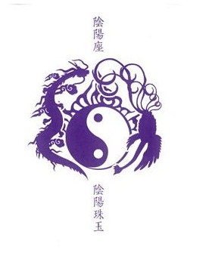
YIN YANG (陰陽)
Everything has a yin or yang essence → foods, cooking methods, business.
The balance of yin yang →harmony.
Text Source: Taiwan A to Z The Essential Cultural Guide
Image source: http://www.amazon.co.jp/陰陽珠玉-陰陽/dp/images/B000CFWPWO

Slide 43

CULTURAL SIGNIFICANCE
An attitude toward life
Bring health, wealth, success and happiness when yin &yang are in equilibrium.
Text Source: Taiwan A to Z The Essential Cultural Guide
Image source: http://www.photolibrary.jp/img174/114426_1013736.html

Slide 44
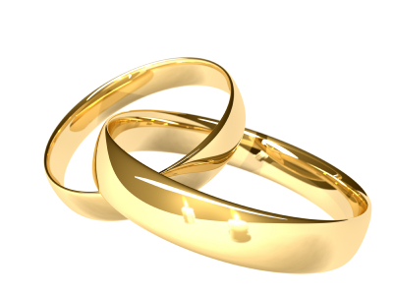
The time of Joey’s life
Marriage
Wedding
customs
Image source: http://infotainmentz.blogspot.com/2011/07/wedding-rings.html

Slide 45
A Taiwanese wedding
Worship the ancestors 祭祖
Picking up the bride 迎娶
Firecrackers /Splash water / Sling a fan
Wedding Banquets
Move forward to bridal chamber & shivaree
After wedding
Notes:
hang

Slide 46
Dos & Don’ts
Even number:
envelopes, cars to pick up the bride, bridesmaids and best men at wedding, etc.
Red envelopes:
Choose number six or number eight
--- similar sounds as fortune and wealthy in Chinese culture

Slide 47
Dos & Don’ts
Not to get married in June & July of the lunar calendar
Bride’s aunts shouldn’t bid the guests farewell.
Not to touch the bed of the newlyweds
A person of the animal sign Tiger of the Chinese zodiac shouldn’t attend the ceremony.

Slide 48
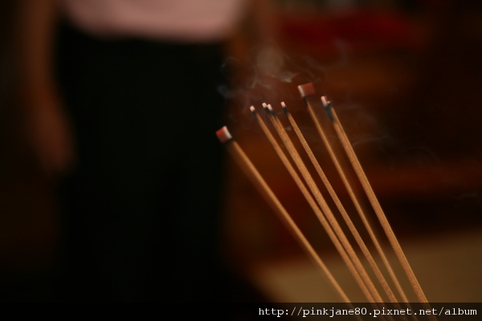
WORSHIP THE ANCESTORS
The Groom
Before picking up the bride.
To inform the ancestors about the new member.
image ources:http://tw.image.search.yahoo.com/search/images?ei=UTF-8&p=%E5%82%B3%E7%B5%B1%E5%A9%9A%E7%A6%AE%E7%BF%92%E4%BF%97&fr2=tab-web&fr=yfp-s

Slide 49
PICK UP THE BRIDE
Set off firecrackers when cars depart for bride’s house
Remember!
The number of limos should be EVEN !!

Slide 50
SPLASH WATER
Bride’s parents
Symbolize- the daughter will not be taken back.
(嫁出去的女兒潑出去的水)
Meaning--
Married women are considered a member of her husband’s family.

Slide 51
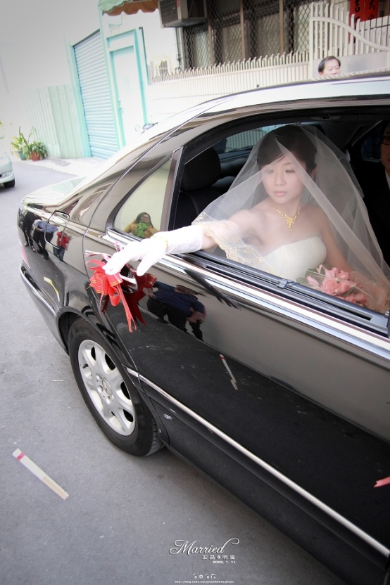
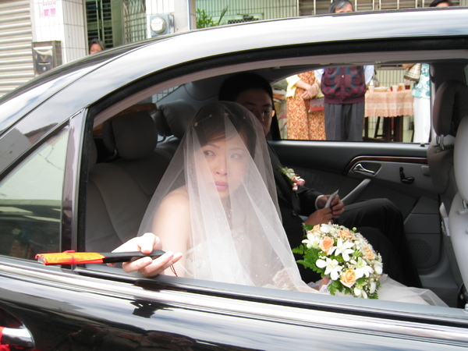
SLING A FAN
After getting on the car, the bride should sling a fan before leaving, without looking back.
image ources:http://tw.image.search.yahoo.com/search/images?ei=UTF-8&p=%E5%82%B3%E7%B5%B1%E5%A9%9A%E7%A6%AE%E7%BF%92%E4%BF%97&fr2=tab-web&fr=yfp-s

Slide 52
RED ENVELOPES
Represents the guests’ greetings.
Even number of cash in the red envelope.
  But!! Avoid the number “FOUR”

Slide 53
COUPLE: TOAST THE GUESTS
The couple
Table by table
Appreciate the guests for attending the wedding

Slide 54
AFTER THE WEDDING
The bride awakes early to worship the ancestors (of the husband’s family) at dawn.
Three Days After the Wedding: Visit the wife’s family (歸寧)

Slide 55
Work Cited
Liu, Amy C. Taiwan A to Z: The Essential Cultural Guide. Taipei: The Community Services Center, 2009. Print.

